Slide 1
TENDER NUMBER: TNPA/2025/08/0010/103591/RFP
COMPULSORY BRIEFING SESSION:
FOR THE DESIGN, DEVELOPMENT, SUPPLY, INSTALLATION AND COMMISSIONING OF PORT OF CAPE TOWN ROBINSON DRY DOCK DEWATERING SYSTEM FOR A PERIOD OF THREE (3) MONTHS
VENUE: PROCUREMENT BOARDROOM
DATE: 24 OCTOBER 2025
TIME: 10H00
PRESENTED BY: SD TEAM
Notes:
Growth and Reinvent

Slide 2
SPECIFIC GOALS

Slide 3
EVALUATION METHODOLOGY – TRANSNET PREFERENTIAL PROCUREMENT POLICY
  In terms of Transnet Preferential Procurement Policy (TPPP) and Procurement Manuals, the following preference points must be awarded to a bidder who provides the relevant required evidence for claiming points.
 | POINTS | POINTS
PRICE | 80 | 90
B-BBEE Status Level of Contributor 1 or 2 | 04 | 02
30% Black Women Owned Entities | 06 | 03
EME or QSE 51% Black Owned | 10 | 05
Non-Compliant and/or B-BBEE level 3-8 Contributors | 00 | 00
Total points for Price and B-BBEE must not exceed | 100 | 100

Slide 4
EVALUATION METHODOLOGY - TRANSNET PREFERENTIAL PROCUREMENT POLICY
The following table represents the evidence required for claiming preference points for applicable specific goals to this tender:
Specific Goals | Acceptable Evidence
B-BBEE Status Level of Contributor 1 or 2 | B-BBEE Certificate / Sworn - Affidavit / CIPC B-BBEE Certificate (in case of JV, a consolidated scorecard will be accepted) as per DTIC guidelines
30% Black Women Owned Entities | Certified copy of ID Documents of the Owners
EME or QSE 51% Black Owned | Audited Annual Financial B-BBEE Certificate / Sworn - Affidavit / CIPC B-BBEE Certificate (in case of JV, a consolidated scorecard will be accepted) as per DTIC guidelines
Note:
Should the evidence required for any of the Specific Goals applicable in this tender not be provided, a tenderer will score zero preference points for that particular “Specific Goals”

Slide 5
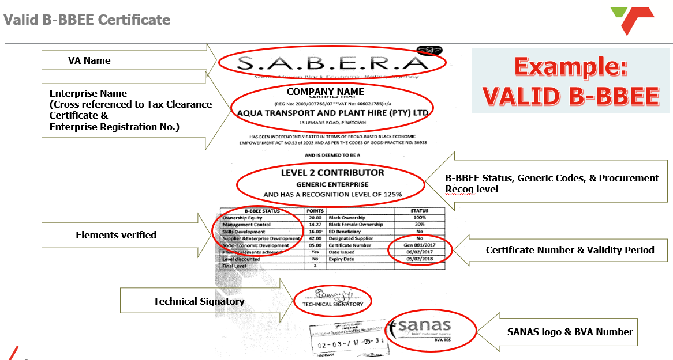
Key Pointers determining the validity of B-BBEE Certificate:

Slide 6
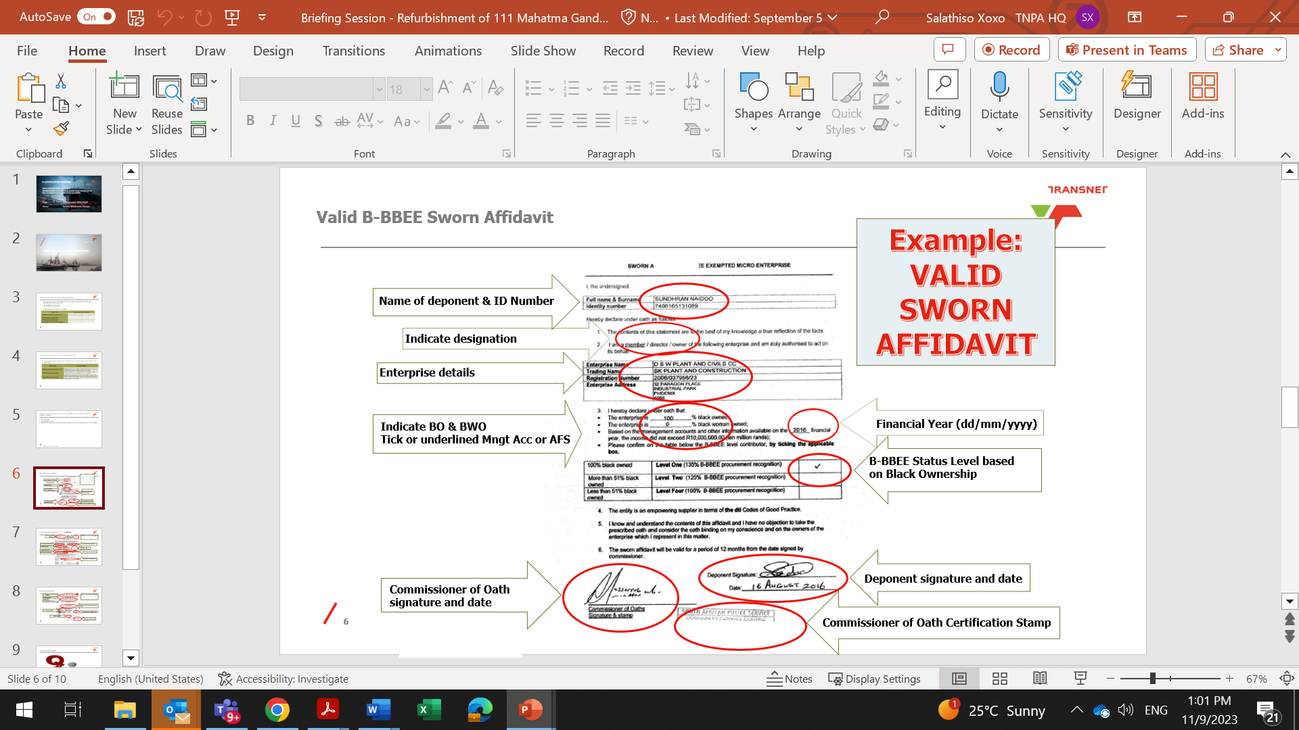
Key Pointers determining the validity of Sworn – Affidavit:

Slide 7
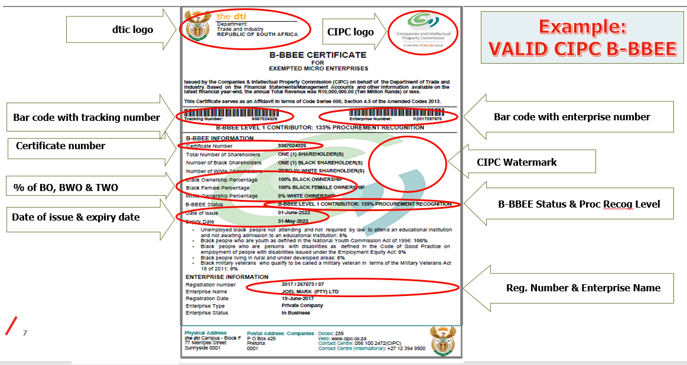
Key Pointers determining the validity of CIPC B-BBEE Certificate:

Slide 8



Q & A SESSION:

